Slide 1
Encapsulation & Inheritance

Slide 2

Objectives
At the end of this session, you will be able to
Implement Classes & Objects
Differentiate Static and Instance members
Use constructors to initialize objects
Understand the garbage collection process
Inherit classes to promote code reusability
Implement singleton design pattern

Slide 3
Agenda
Classes & Objects
Static and Instance members.
Constructors
Garbage Collection
Inheritance
Singleton Design Pattern

Slide 4
Terminologies:
Class: A blueprint for an instance
Instance: A constructed object of the class
Type: Indicates the class the instance belongs to
Attribute: Property that describes the instance
Method: A “callable function” defined in the class

Slide 5


Concept of Class
A class is a description of a group of objects with common properties (attributes) & behavior (operations)
An object is an instance of a class
e.g. Mary is an object of Student class
Jane is an object of Student class
Mary 1001
Jane 1002
name
rollNo
name
rollNo

Slide 6
Example of class
Data Members (State)
class Car {
String color;
int yearOfManufacture;
public void accelerate(){ }
}
}
Here class is a keyword and Car is the name of the class having attributes color and yearOfManufacture and a method accelerate().
Method (Behavior)

Slide 7
Object
An object is an instance of a class
The new operator creates a object & returns a reference to it
Memory allocation of objects happens in the heap area
Reference returned can be stored in reference variables
Car c;
c = new Car();
or
Car c = new Car();
c is a reference variable
new keyword creates an object and returns a reference to it

Slide 8
Instance Members
A member, either a variable or a method, declared within a class is an instance member.
The runtime system creates a copy of each instance variable for every object created for that class.
An instance member is initialized to its default value.
public class Car{
String color; //instance variables
int yearOfManufacture;
public void accelerate(){ } //instance method
}

Slide 9
Instance Members
public class Car{
String color;
int yearOfManufacture;
public void accelerate(){
}
}
Memory Heap
color
yearOfManufacture
Object
color
yearOfManufacture
Object
Car car1
=
new Car();
Car car2
=
new Car();
car1.accelerate();
car1
car2
References

Slide 10
Java Naming Conventions
Class names are nouns in upper camel case.
public class Car{
private final int MAXSPEED = 200;
private String color;
private int yearOfManufacture;
public String getColor(){
return color;
}
public void setColor(String color){
this.color=color; }
public void accelerate(){
// ...
}
}
Constants should be in all uppercase letters
Variable names in lower camel case.
Methods should be verbs, in lower camel case.
Notes:
Class names should be nouns in mixed case, with the first letter uppercase and the first letter of each internal word capitalized. This is approach is termed "upper camel case."
Methods should be verbs in mixed case, with the first letter lowercase and the first letter of each internal word capitalized. This is termed "lower camel case."
Variable names should be short but meaningful. The choice of a variable name should be mnemonic: designed to indicate to the casual observer the intent of its use.
One-character variable names should be avoided except as temporary "throwaway" variables.
Constants should be declared using all uppercase letters. Note: The keyword final is used to declare a variable whose value may only be assigned once. Once a final variable has been assigned, it always contains the same value. You will learn more about the keyword final in the lesson "Advanced Class Design."
For the complete Code Conventions for the Java Programming Language document, go to http://www.oracle.com/technetwork/java/codeconv-138413.html.

Slide 11
Encapsulation: Private Data, Public Methods
Encapsulation wraps the internal workings of a Java object.
One way to hide implementation details is to declare all of the fields private
public class Car{
private final int MAXSPEED = 200;
private String color;
private int yearOfManufacture;
public String getColor(){
return color;
}
public void setColor(String color){
this.color=color; }
public void accelerate(){
// ...
}
}
Declaring fields private prevents direct access to this data from a class instance.
Public methods to set and get the current field value.
Notes:
Class names should be nouns in mixed case, with the first letter uppercase and the first letter of each internal word capitalized. This is approach is termed "upper camel case."
Methods should be verbs in mixed case, with the first letter lowercase and the first letter of each internal word capitalized. This is termed "lower camel case."
Variable names should be short but meaningful. The choice of a variable name should be mnemonic: designed to indicate to the casual observer the intent of its use.
One-character variable names should be avoided except as temporary "throwaway" variables.
Constants should be declared using all uppercase letters. Note: The keyword final is used to declare a variable whose value may only be assigned once. Once a final variable has been assigned, it always contains the same value. You will learn more about the keyword final in the lesson "Advanced Class Design."
For the complete Code Conventions for the Java Programming Language document, go to http://www.oracle.com/technetwork/java/codeconv-138413.html.

Slide 12
Class (or static) Members
A class member is declared by using the static modifier
The static members belong to the class not to a specific object and hence a single copy is shared by all objects
static keyword can be used in three scenarios:
For class variables
For methods
For a block of code

Slide 13
Using static
static variable
Belongs to a class
A single copy to be shared by all instances of the class
Creation of instance not necessary for using static variables
Accessed using <class-name>.<variable-name> unlike instance variables which are accessed as <object-name>.<variable-name>
static method
It is a class method
Accessed using <class name>.<method name>
Creation of instance not necessary for using static methods
A static method can access only other static data & methods, and not non-static members
Notes:
Static
Static Variables : All instances of the same class share a single copy of the static variables. Static variables are initialized to default values when the class is loaded into memory.i.e Variables of type boolean are set to false, Numbers are set to zero, any variable that act as an object reference is set to null.
However u can assign value to static var at the time of decleration.
Static type varName1=expr1;
Static variables are initialized when a class is loaded. A Class can be loaded when :
JVM decides its time to load because somebody is trying to make new instance of the class for the first time.
Use a static method or variable of a class.
2 Guarantees about static initialization are :
Static variables in a class are initialized before any object of that class can be created.
Static Variables in a class are initialized before any static method of the class runs.
Static Method
May be declared by using static keyword as a modifier.
A static method act relative to a class.
It doesn’t act on specific object of its class.
A Non-Static method can access static data it doesn’t give any error.
The static modifier can be applied to class variables, methods, and even a code that is not a part of method. It cannot be assigned to a top-level class definition but it can be assigned to an inner class level definition. (The concept of inner class will be discussed later)
A static class member can be accessed directly by the class name and doesn’t need any object. A single copy of a static member is maintained through out the program regardless of the number of objects created.
Static variables are initialized only once and at the start of the execution during the lifetime of a class. These variables will be initialized first before the initialization of any instance variables.
The following are to be noted about static methods:
They can only call other static methods.
They must only access static data. Attempt to access non-static data causes a compiler error.
They cannot refer to this or super in anyway. (The keyword super will be discussed later)
These methods can be accessed using the class name rather than a object reference.
main() method should be always static because it must be accessible for an application to run, before any instantiation takes place.
When main() begins, no objects are created, so if you have a member data, you must create an object to access it.

Slide 14
Using static
static block: A block of statement inside a Java class that is executed only once when a class is loaded
Used to initialize static variables of the class
Static blocks cannot return. They are simply nameless blocks of code that
execute in the order they are specified.
class Test{
static{
//Code goes here
}
}
Notes:
You may define a block of statements to be executed when a class is loaded into memory. This is known as static initialization block.

Slide 15
Static and Instance Members
public class ClassMemberDemo{
int instanceVariable;
static int staticVariable;
void static staticMethod(){ }
void instanceMethod(){ }
// In main method
ClassMemberDemo cm=new ClassMemberDemo ();
}
instanceVariable
instanceMethod()
Object
staticVariable
staticMethod()
cm
Memory Heap
Memory Stack
Reference

Slide 16
Static and Instance Members
Static methods can access static variables.
instanceVariable
instanceMethod()
Object
staticMethod()
staticVariable
Memory Stack
Memory Heap

Slide 17
Static and Instance Members
Instance methods can access static variables.
instanceVariable
instanceMethod()
Object
staticMethod()
staticVariable
Memory Stack
Memory Heap

Slide 18
Static and Instance Members
Static methods cannot directly access instance variables or methods.
instanceMethod()
instanceInteger
Object
staticMethod()
classVariable
Memory Stack
Memory Heap

Slide 19
Constructors
A constructor:
is a method with exactly the same name as the class to which it belongs.
has no return type
called automatically every time when an object is created for the class
used to Initialize the instance variables to required or default values at the time of object creation
class Car{
String color;
Car() {
color=“white”;
}
}
A simple no-argument (no-arg) constructor to initialize instance variables of the class
Car c1 = new Car(); // Creates a White color car
Car c2 = new Car(); // Another White color car

Slide 20
Constructors
If you don’t type a constructor in a class, the default constructor (no-arg) will be automatically generated by the compiler.
The instance variables are initialized to its default values
Numeric data types are set to 0
Char data types are set to null character (‘\0’)
Reference variables are set to null
class Car{
String color;
}
A default constructor will be supplied by compiler
Car(){
super();
}
Car c = new Car(); // A Car object with color set to null

Slide 21


Parameterized Constructor
A constructor can be parameterized
Once a constructor is written for a class, the default constructor will not be supplied
Class Car{ String color; Car(String c){ color=c; } } | Different Car objects can be created with different colors But a color MUST be specified
Car yellowcar = new Car(“yellow”);
Car redcar = new Car(“red”);
Car noColorCar = new Car();

Slide 22
Overloaded Constructor
Constructors can be overloaded
Class Car{ String color; Car(){ color=null; } Car(String c){ color=c; } } | Multiple constructors with different arguments can be written for a class Now a Car object can be created with or without a color
Car yellowcar = new Car(“yellow”);
Car redcar = new Car(“red”);
Car noColorCar = new Car();

Slide 23
Use of this keyword
“this” keyword refers to the current object
Class Car{ String color; Car(){ color=null; } Car(String color){ this.color=color; } } | The keyword this here was used to refer the instance variable color of the current object

Slide 24
Scope of Variables
Instance Variables (also called Member Variables)
Declared inside a class
Outside any method or constructor
Belong to the object
Stored in heap area with the object to which they belong
Lifetime depends on the lifetime of object
Initialized to default values
Local Variables (also called Stack Variables)
Declared inside a method
Method parameters are also local variables
Stored in the program stack along with method calls and live until the call ends
Not initialized implicitly and hence cannot be accessed before initialization
Notes:
Member & Automatic variables :
Java supports variables of two different lifetimes:
A member variable is the one which is created when an instance or an object is created, and is accessible from any method in the class.
An automatic variable is similar to the local variable. It is alive as long as the control is within the function. The programmer must initialize a local variable before it is used.
Member Variables
Defined in a class, outside methods or constructors.
They are alive as long as the object exists.
Automatic Variables or Local Variables
These are declared within methods or blocks
They are alive as long as the control is within the function.
Variables passed as parameters also fall in this category

Slide 25
Scope of Variables
class Student{
int rollNo;
String name;
public void display (int z){
int x;
System.out.println(rollNo);// Prints 0
System.out.println(z); // Prints 100
System.out.println(x); //ERROR
}
public static void main(String a[]){
Student s=new Student();
s.display(100);
}
}
rollNo and name are instance variables stored in the heap
z and x are local variables stored in the stack

Slide 26
Garbage Collection
When an object is instantiated using the new keyword, memory is allocated in heap for the object.
Garbage collection is a mechanism for reclaiming memory from objects that are no longer referenced by the program, and making the memory available for new objects.
JVM does the garbage collection and is not the responsibility of the programmer.
It runs in a low priority thread and may kick in when memory is too low but no guarantee.
It’s not possible to force garbage collection. Invoking System.gc() may start garbage collection process.
finalize method is used to release system resources other than memory (such as file handles, network / database connections).

Slide 27

Garbage Collection
This object can be garbage collected
Car car1 = new Car(“yellow”);
Car car2 = new Car(“red”);
car2 = car1;
Memory Heap
car1
car2

Slide 28
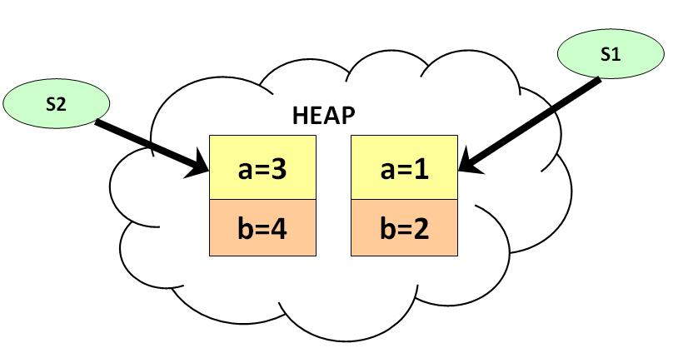
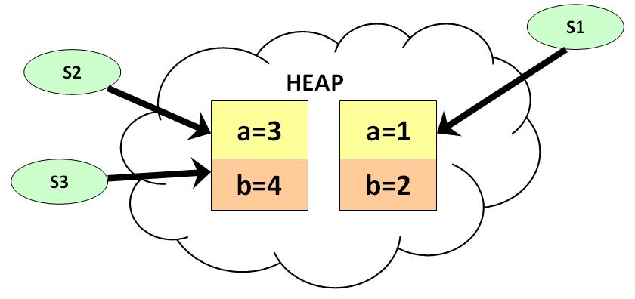
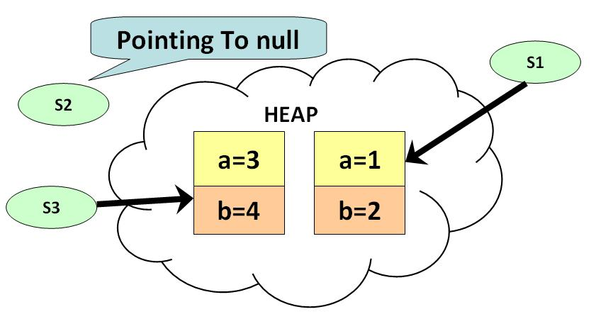
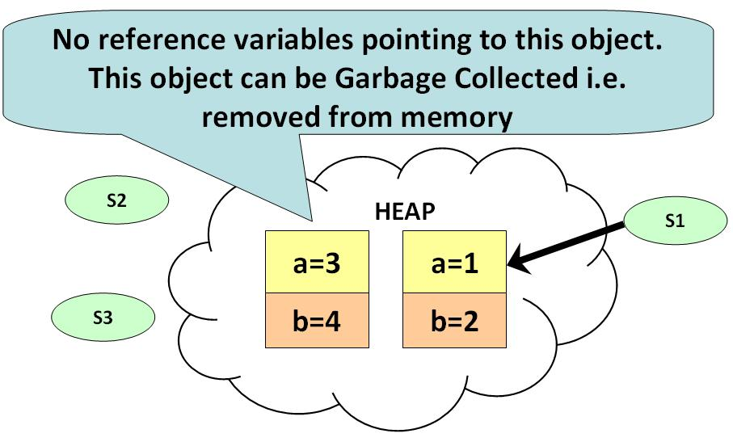

How Garbage Collection Works ?
Garbage Collection Important Points to Note:
1) If you want to make your object eligible for Garbage Collection , assign its reference variable to null.
2) Primitive types are not objects. They cannot be assigned null.

Slide 29
Inheritance
Inheritance facilitates reusability of code by deriving a new class from an existing one
The existing class is called the parent/super/base class
The derived class is called the child/derived/sub class
The child inherits characteristics, i.e. the methods and data defined, from the parent
A class can extend only one base class
All Java classes are extended from a common base class (java.lang.Object) automatically

Slide 30
Inheritance
Vehicle
All common properties would be here
color
maxSpeed
brand
drive()
Newly added property
Inherited properties
Inheritance should create an is-a relationship, meaning the child is a more specific version of the parent
is-a
is-a
Car
Truck
color
maxSpeed
brand
passengerSeat
color
maxSpeed
brand
CargoBay
drive()
drive()
load()
unload()

Slide 31
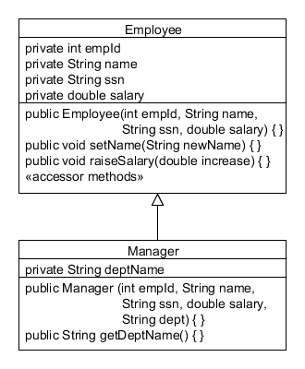
Inheritance is also called as Subclassing
In an object-oriented language like Java, subclassing is used to define a new class in terms of an existing one.
superclass: Employee ("parent" class)
this means "inherits"
subclass: Manager, is an Employee
("child" class)

Slide 32
Inheritance
In Java, we use the reserved word extends to establish an inheritance relationship
class Car extends Vehicle
{
// class contents
}
All base class fields & methods are inherited by the subclass
private members of the super class cannot be accessed by the subclass
static members of the base class are also inherited
protected members of the super class are inherited by subclass
In addition to the inherited members of base class, the sub classes can add its own set of attributes and behaviors specific to them

Slide 33
Using super keyword
The keyword super refers to members of the super class
Used when member names of the subclass hide members by the same name in the super class
super.member
member can be either a method or an instance variable

Slide 34
Constructors in Subclasses
Constructors are invoked in the order of hierarchy
While instantiating a sub class, its super class default constructor will be invoked first, followed by the sub class constructor
This is because of the compiler inserting super() as the first statement in every sub class constructor
Notes:
Constructors in Subclasses
Every subclass inherits the non-private fields and methods from its parent (superclass). However, the subclass does not inherit the constructor from its parent. It must provide a constructor.
The Java Language Specification includes the following description:
“Constructor declarations are not members. They are never inherited and therefore are not subject to hiding or overriding.”

Slide 35
Constructors in Subclasses
Compiler inserts super() to call default constructor of Object class
class Animal{
Animal(){
System.out.println("In Animal");
}}
class Cat extends Animal{
Cat(){
System.out.println("In Cat");
}}
class Tom extends Cat{
Tom(){
System.out.println("In Tom");
}}
public class Main{
public static void main(String[] args){
Tom obj = new Tom();
}}
Output
In Animal
In Cat
In Tom
Compiler inserts super() to call default constructor of Animal class
Compiler inserts super() to call default constructor of Cat class

Slide 36
Using super() and this()
super() calls the default constructor of the parent class.
Use super(args), if you want to invoke the super class parameterized constructor instead of the default constructor
Use this() to call another constructor in the same class.
super() or this() call must be the first statement in the body of a constructor.

Slide 37
Example
package com.example.domain;
public class Manager extends Employee {
private String deptName;
public Manager (int empId, String name,
String ssn, double salary, String dept) {
super (empId, name, ssn, salary);
this.deptName = dept;
}
public String getDeptName () {
return deptName;
}
// Manager also gets all of Employee's public methods!
}
The super keyword is used to call the constructor of the parent class. It must be the first statement in the constructor.
Notes:
Java Syntax for Subclassing
The keyword extends is used to create a subclass.
The Manager class, by extending the Employee class, inherits all of the non-private data fields and methods from Employee. After all, if a manager is also an employee, then it follows that Manager has all of the same attributes and operations of Employee.
Note that the Manager class declares its own constructor. Constructors are not inherited from the parent class. There are additional details about this in the next slide.
The constructor that Manager declares in line 4 calls the constructor of its parent class, Employee, using the super keyword. This sets the value of all of the Employee fields: id, name, ssn, and salary. Manager is a specialization of Employee, so constructing a Manager requires a department name, which is assigned to the deptName field in line 7.
What other methods might you want in a model of Manager? Perhaps you want a method that adds an Employee to this Manager. You can use an array or a special class called a collection to keep track of the employees for whom this manager is responsible. For details about collections, see the lesson titled “Generics and Collections.”

Slide 38
Design Patterns:
Design patterns are:
Reusable solutions to common software development problems
Documented in pattern catalogs
Design Patterns: Elements of Reusable Object-Oriented Software, written by Erich Gamma et al. (the “Gang of Four”)
A vocabulary used to discuss design

Slide 39

Singleton pattern
When and why is singleton pattern needed?
There are objects whose only one instance is needed,
Example: registry handler object.
regHandler()
Registry
Settings
regHandler()

Slide 40
Singleton pattern
Objectives of Singleton Pattern
Create a class and let it manage one and only one instance of itself
Prevent other classes from creating a new instance
Provide a global access point to the instance

Slide 41
Creating a Singleton Pattern
Step 1:
Provide a private constructor so that no one can directly create an object of the class
Step 2:
Provide a public static getter method inside the same class, that returns a unique instance of the class.
This method creates a new instance of the object if one does not exist.
If an instance already exist, it simply returns a reference to that object.

Slide 42
Creating a Singleton Pattern
The singleton design pattern details a class implementation that can be instantiated only once.
public class SingletonClass {
private static final SingletonClass instance =
new SingletonClass();
private SingletonClass() {}
public static SingletonClass getInstance() {
return instance;
}
}
1
2
3

Slide 43
Creating a Singleton Pattern
public class RegHandler{
private static RegHandler regHandler; //only one instance
private RegHandler(){} /* private constructor – to prevent other classes from instantiating the class */
public static RegHandler getInstance() {
if (regHandler==null) { // if object doesn’t exist
regHandler=new RegHandler(); // creates only one instance
}
return regHandler; // returns existing object’s reference
}
}

Slide 44
Try it out
Q1. _______ members belong to the class in which they are declared and are not part of any instance of the class.
a) class
b) static
c) instance
d) final
Q2. Will the below code compile?
class Foo{
int foo = 10;
public static void main(String a[]) {
System.out.println(foo);
}
}

Slide 45
Try it out
Q3. The runtime system creates one copy of each instance variable for each instance of a class created by a program. (True/False)
Q4. Which statements are correct? A constructor:
is a method with exactly the same name as the class to which it belongs.
b) has int return type.
c) initializes an object immediately upon creation.
d) can be parameterized.
Q5. The first line in a constructor must be a call to either ________ or _______

Slide 46
Try it out
Q6. For which of the below classes, will the compiler put in a default constructor?
a) class Horse {
Horse( ) { }
Horse(String name) { }
}
b) class Horse {
Horse(String name) { }
}
c) class Horse {
}
d) class Horse{
void Horse(){ }
}

Slide 47
Try it out
Q7. Assume the below class is written by you. In line 3, the compiler will automatically insert a code. What is it?
1. class Horse {
2. Horse( ) {
3. __________ // Compiler generated code is here
4. System.out,println(“This is my default constructor”);
5. }
6. }
Q8. What is to be done in the below code to fix the compiler error?
class Animal {
Animal(String name) { }
class Horse extends Animal {
Horse( ) { }
}

Slide 48
Summary
In this session, we have covered:
Classes & Objects
Static and Instance members.
Constructors
Garbage Collection
Inheritance
Singleton Design Pattern

Slide 49
Thank you

